Slide 1




Slide 2



Slide 3

http://www.tubitak.gov.tr/sites/default/files/1512-surec-2017.pdf

Slide 4
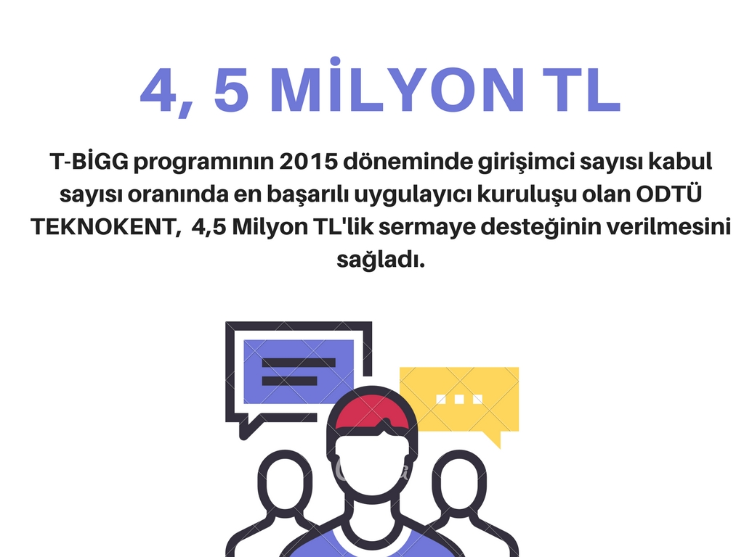

Slide 5



Slide 6


Slide 7



https://drive.google.com/open?id=1KXKJlCKGiWlhY4uBQ5Ay7T4-crY5hqVKtg1PEq1eaGI

Slide 8
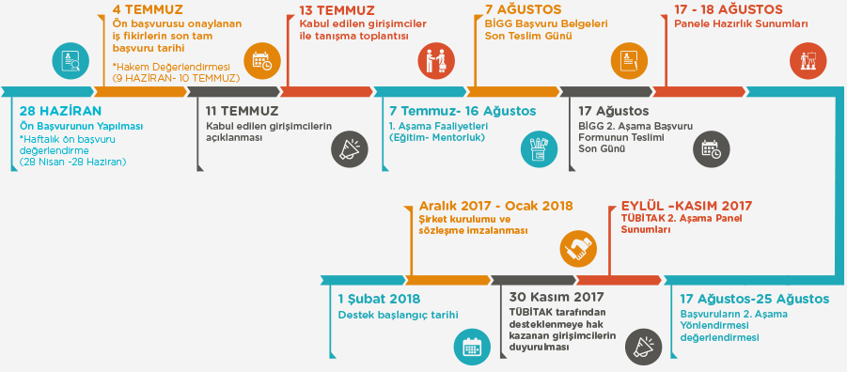

Slide 9

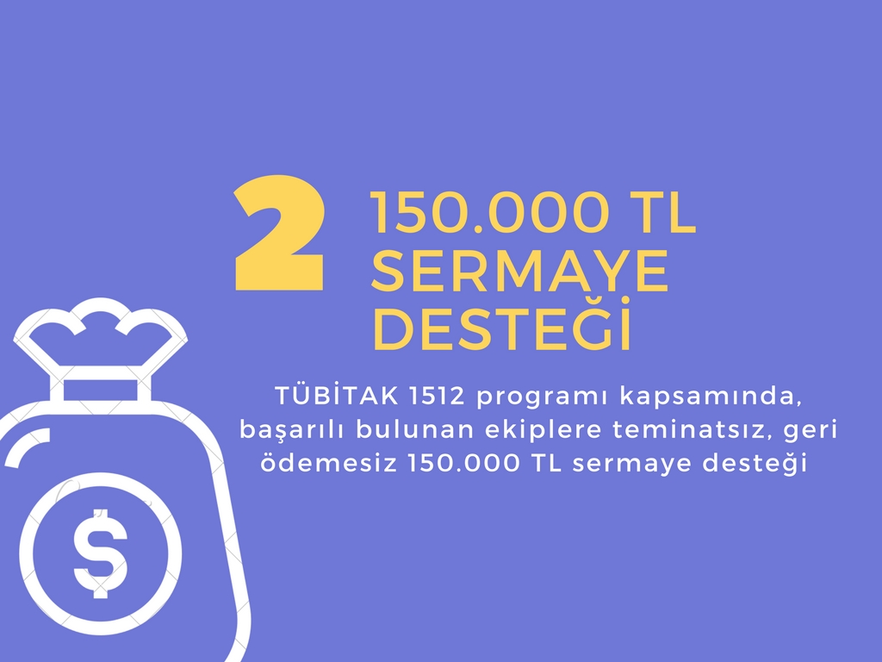

Slide 10
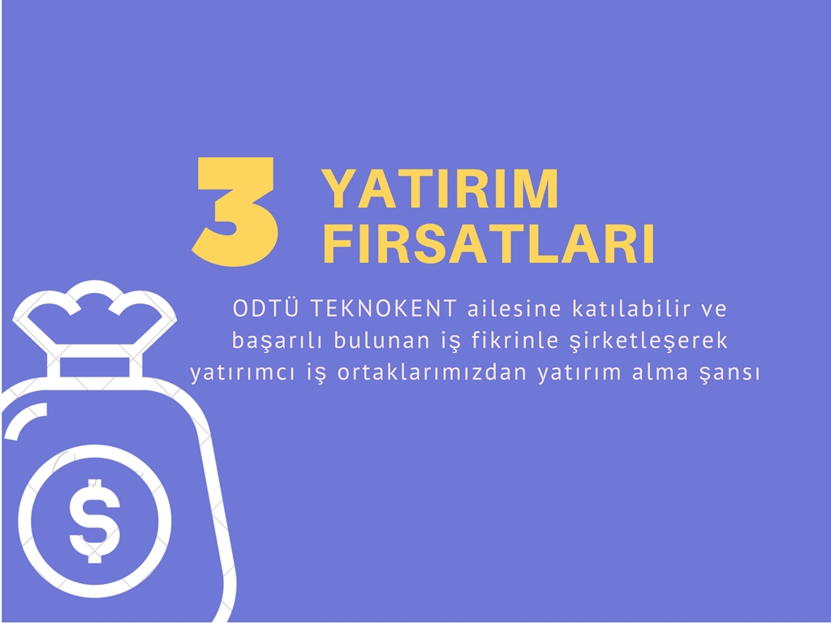



Slide 11



Slide 12
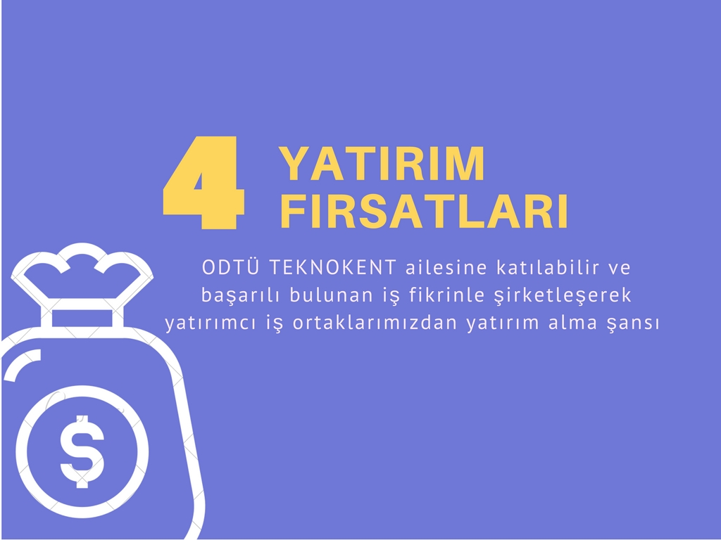


Slide 13



Slide 14
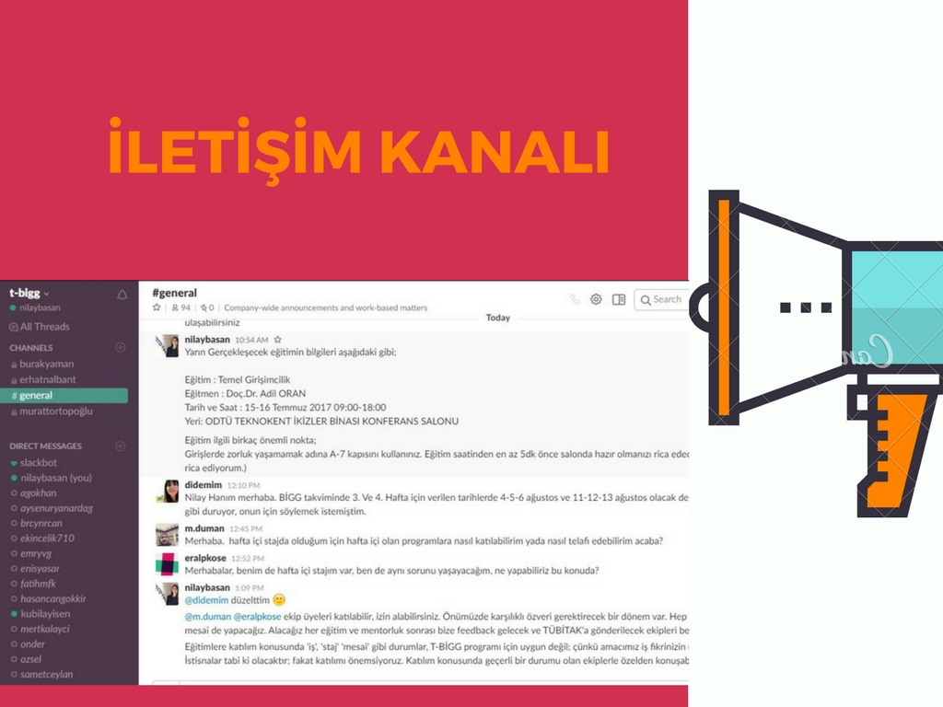

https://join.slack.com/t/t-bigg2017/shared_invite/MjEwNzU1ODgzNjAzLTE0OTk3NTU4MDItMjg3NDQ1MWMyZg

Slide 15

https://docs.google.com/spreadsheets/d/1lGhAHTd8C5p_szgb2OhCXjN7YLev7n6Yw6V1AGlCY_0/edit?usp=sharing

Slide 16
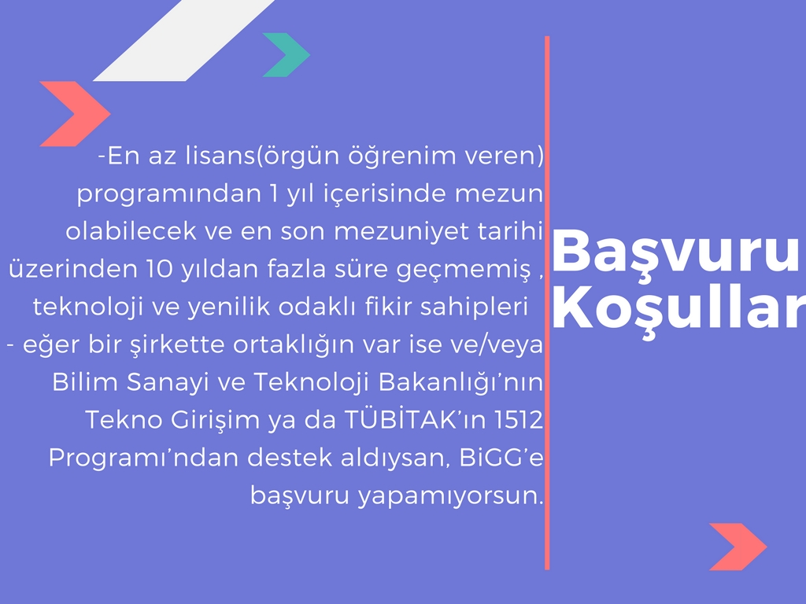
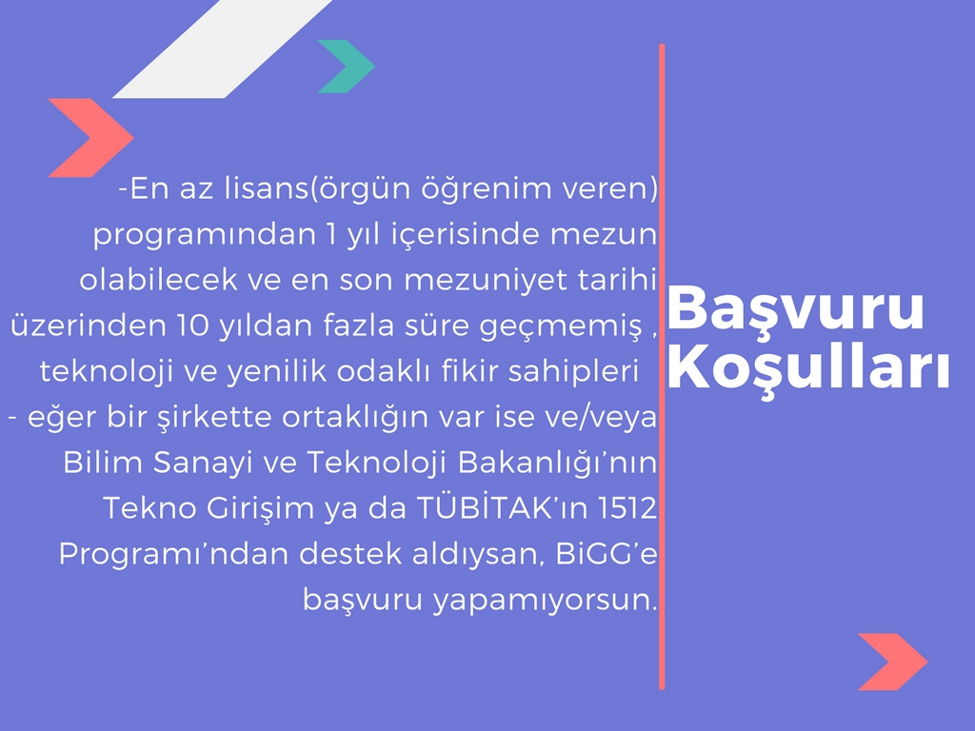

Slide 17
